Slide 1
ROAD DAMAGE PREDICTION FOR INTELLIGENT TRANSPORTATION SYSTEM
VARSHA C
MES20MCA-2058
PRODUCTOWNER: NOWSHAD CV

Slide 2
TABLE OF CONTENTS
Introduction
Methodology
Modules
Future Enhancement
User Story
Project Plans
Product Backlog
Sprint plans
Sprint Actual
Screenshots

Slide 3
ROAD DAMAGE PREDICTION FOR INTELLIGENT TRANSPORTATION SYSTEM
A human-based road damage monitoring system could be the first answer but not a perfect solution because it is affected by a different condition such as weather, speed of the vehicle, the complexity of the road, and the difference of criteria from the individual inspection. Thus, researchers have developed much more robust and accurate automatic road surface detectors through various methods. For example, using a probabilistic relaxation technique based on 3D information , combining 2D gray-scale image and 3D laser scanning data or implementing a deep learning-based model . In this challenge, the dataset is gathered by a Smartphone based method and we evaluated with various scenarios using YOLO based on a deep learning-based algorithm. It is light-weight and fast in the object detection task, so it is available to improve the Smartphone-based model for detecting road damage. Deep learning-based technology is a good key to unlock the object detection tasks in our real world. By using deep neural networks, we could break a problem that is dangerous and very time-consuming but has to be done every day like detecting the road state. This paper describes the solution using YOLO to detect the various types of road damage in the IEEE Big Data Cup Challenge 2020. Our YOLOv5x based-solution is light-weight and fast, even it has good accuracy. We achieved an F1 score of 0.58 using our ensemble model with TTA, and it could be an adequate candidate for detecting real road damage in real-time.

Slide 4
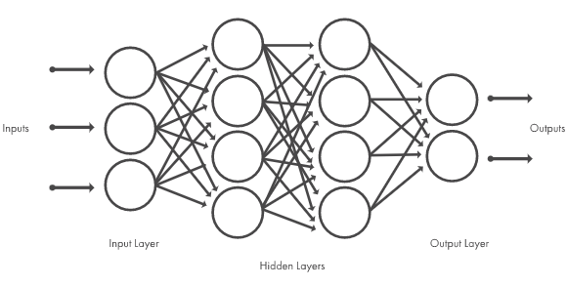
METHODOLOGY
DEEP LEARNING
Deep learning is a machine learning technique that teaches computers to do what comes naturally to humans.
Deep learning models are trained by using large sets of labeled data and neural network architectures that learn features directly from the data without the need for manual feature extraction.
Nowadays, deep learning has an important role in image classification. It extracts the feature maps from an input image using a neural network with hidden layers, and several deep learning networks based on Convolutional Neural Networks (CNNs), such as AlexNet , VGGNet , ResNet , etc, achieved a successful performance in the ImageNet Large Scale Visual Recognition Challenge (ILSVRC).

Slide 5
METHODOLOGY
DEEP LEARNING
A main point is that object detection could be a combination of classification and localization, thus many approaches have developed to solve object detection tasks using deep learning-based technology. The detection model is trained with the image dataset which contains the bounding-boxes and the labels to detect an object. From the perspective of region proposal-based methods, they propose a region that may include the object, classify the object, refine and get rid of overlapped bounding boxes, and score them based on other objects in the input image. And there are representative region-based models such as R-CNN , Fast R-CNN , and Faster R-CNN , and they also called by two-stage object detectors.

Slide 6
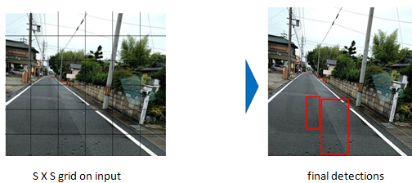
METHODOLOGY
YOLO ALGORITHM
YOLO(You Only Look Once) has a single neural network architecture, predicts a set of bounding boxes and class probabilities at a sitting for every test image.
First of all, it divides the full image by several a grid with a specific size, and anchor boxes are generated in every grid of input image by predefined scale and size. Each anchor box predicts the objectness score, box center offset x, box center offset y, box width, box height, and class scores at one time in contrast to a two stage detector.
Thus, YOLO is an extremely fast end-to-end algorithm to detect the objects, and it is called a one stage object detector. Also, the performance of YOLO has improved over the development of deep learning technology, so there are updated versions for improving the light-weight, inference speed, and accuracy.

Slide 7
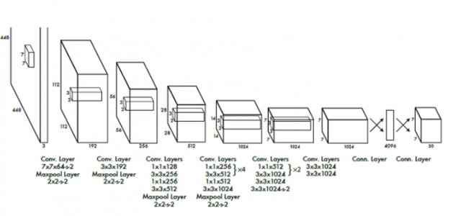
METHODOLOGY

Slide 8
MODULES
Admin
Login
View users details
Add notification
View feedback
Track user
Add and manage routs
User
Register
Login
View profile
Road quality alert
feedback
View rout

Slide 9
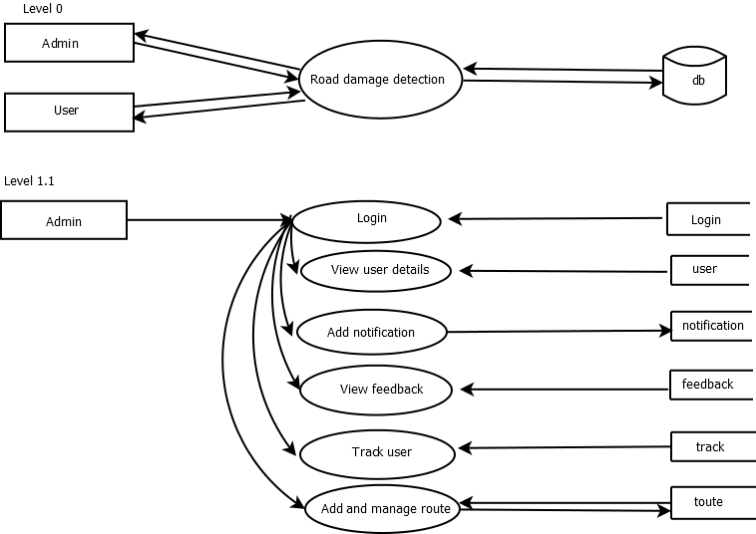
DATA FLOW DIAGRAM

Slide 10
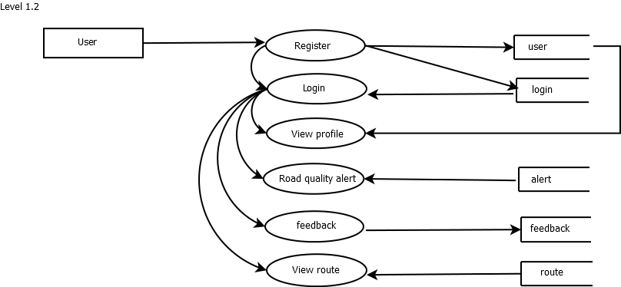
DATA FLOW DIAGRAM

Slide 11
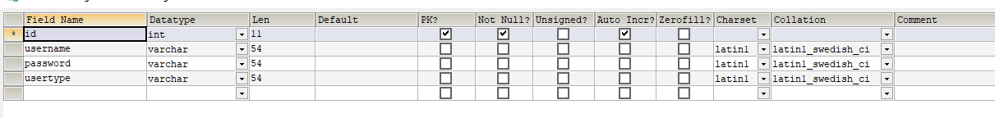
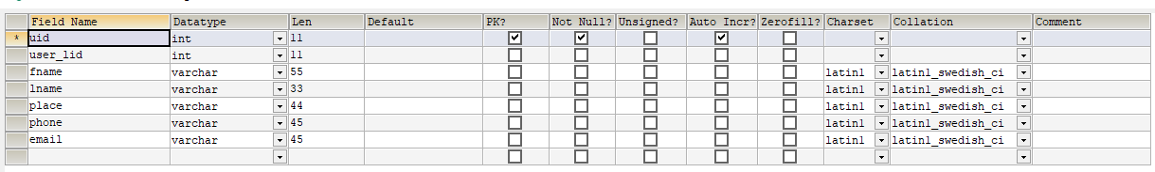
TABLE DESIGN
login
user

Slide 12
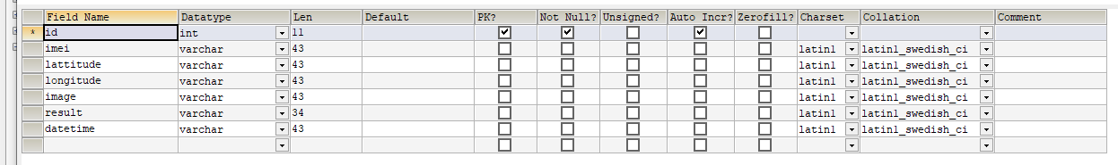
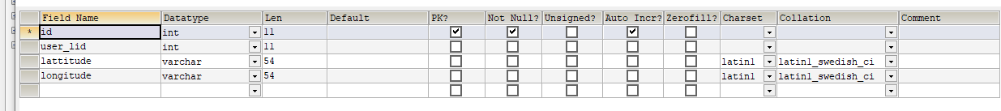
TABLE DESIGN
alert
track

Slide 13
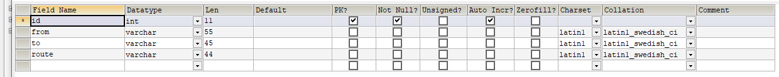
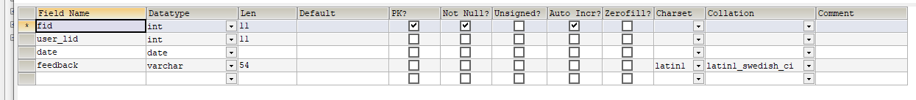
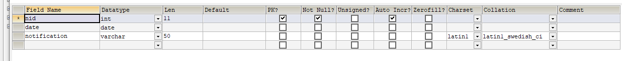
TABLE DESIGN
route
feedback
notification

Slide 14
DEVELOPING ENVIRONMENT
OPERATING SYSTEM : WINDOWS 10
FRONT END : HTML, CSS, JAVASCRIPT
BACK END : Mysql
SOFTWARES USED : Jetbrains Pycharm , Android Studio
TECHNOLOGY USED : PYTHON,JAVA
FRAME WORK USED : Flask

Slide 15
FUTURE ENHANCEMENT
Provides alert to PWD for repair roads.

Slide 16
USER STORY
User Story ID | As a type of User | I want to <perform some task> | So that I can < Achieve Some Goal>
1 | Admin | Login | login successful with correct username and password
2 | Admin | View User details | Can view registered users
3 | Admin | Add& manage notification | Insert ,view & remove notification
4 | Admin | View feedback | Can view feedbacks from user
5 | Admin | Track user | Track users who are travelling
6 | Admin | Add and manage rout | Can add and manage rout
7 | User | Register | Can users register
8 | User | Login | Registered users can login with correct username and password
9 | User | View profile | View users profile in application
10 | User | Road quality alert | Can get alert while travelling
11 | User | Feedback | Can provide feedback
12 | User | View rout | Can view rout in application

Slide 17
PROJECT PLAN
User Story ID | Task Name | Start Date | End Date | Days | Status
1 | Sprint 1 | 26/12/2021 | 28/12/2021 | 10 | completed
2 |  | 29/12/2021 | 31/12/2021 |  | completed
3 |  | 03/01/2022 | 08/01/2022 |  | completed
3 | Sprint 2 | 09/01/2022 | 16/01/2022 | 13 | Completed
4 |  | 18/01/2022 | 22/01/2022 |  | Completed
5 | Sprint 3 | 23/01/2022 | 27/01/2022 | 12 | Completed
6 |  | 30/01/2022 | 05/02/2022 |  | Completed
7 | Sprint 4 | 06/02/2022 | 10/02/2022 | 9 | Completed
8 |  | 16/02/2022 | 19/02/2022 |  | Completed

Slide 18
PRODUCT BACKLOG
User Story ID | Priority <High/Medium/Low> | Size (Hours) | Sprint <#> | Status <Planned/In progress/Completed> | Release Date | Release Goal
1 | Medium | 2 | 1 | Completed | 08/01/2022 | Table design
2 | High | 3 |  | Completed | 08/01/2022 | Form design
3 | High | 5 |  | Completed | 08/01/2022 | Basic coding
3 | High | 5 | 2 | Completed | 22/01/2022 | Data collection
4 | Medium | 5 |  | Completed | 22/02/2022 | Data processing
5 | High | 5 | 3 | Completed | 05/02/2022 | Prediction
6 | medium | 5 |  | Completed | 05/02/2022 | Location based alert
7 | Medium | 5 | 4 | Completed | 20/02/2022 | Testing data
8 | High | 5 |  | Completed | 20/02/2022 | Output generation

Slide 19
SPRINT BACKLOG
Backlog Item | Status And Completion Date | Original Estimation in Hours | Day 1 | Day 2 | Day 3 | Day 4 | Day 5 | Day 6 | Day 7 | Day 8 | Day 9 | Day 10 | Day 11 | Day 12 | Day 13 | Day 14
UserStory#1,#2,#3 |  |  | hrs | hrs | hrs | hrs | hrs | hrs | hrs | hrs | hrs | hrs | hrs | hrs | hrs | hrs
Table Designing | 28/12/2021 | 2 | 1 | 1 | 0 | 0 | 0 | 0 | 0 | 0 | 0 | 0 | 0 | 0 | 0 | 0
Form Designing | 31/12/2021 | 3 | 0 | 0 | 1 | 1 | 1 | 0 | 0 | 0 | 0 | 0 | 0 | 0 | 0 | 0
Coding | 8/01/2022 | 5 | 0 | 0 | 0 | 0 | 0 | 1 | 1 | 1 | 1 | 1 | 0 | 0 | 0 | 0
UserStory#4, #5
Data collection | 16/01/2022 | 5 | 1 | 1 | 0 | 1 | 1 | 1 | 0 | 0 | 0 | 0 | 0 | 0 | 0 | 0
Data processing | 22/01/2022 | 5 | 0 | 0 | 0 | 0 | 0 | 0 | 0 | 1 | 1 | 0 | 1 | 1 | 1 | 0
UserStory#6,#7
Prediction | 27/01/2022 | 5 | 1 | 1 | 1 | 0 | 1 | 1 | 0 | 0 | 0 | 0 | 0 | 0 | 0 | 0
Location based alert | 5/02/2022 | 5 | 0 | 0 | 0 | 0 | 0 | 0 | 0 | 1 | 1 | 1 | 1 | 1 | 0 | 0
UserStory#8,#9
Testing Data | 10/02/2022 | 5 | 1 | 1 | 1 | 1 | 1 | 0 | 0 | 0 | 0 | 0 | 0 | 0 | 0 | 0
OutputGenaration | 20/02/2022 | 5 | 0 | 0 | 0 | 0 | 0 | 0 | 2 | 2 | 1 | 0 | 0 | 0 | 0 | 0
Total |  | 40 | 4 | 4 | 3 | 3 | 4 | 3 | 3 | 5 | 4 | 2 | 2 | 2 | 1 | 0

Slide 20
ACTUAL SPRINT
Backlog Item | Status And Completion Date | Original Estimation in Hours | Day 1 | Day 2 | Day 3 | Day 4 | Day 5 | Day 6 | Day 7 | Day 8 | Day 9 | Day 10 | Day 11 | Day 12 | Day 13 | Day 14
UserStory#1,#2,#3 |  |  | hrs | hrs | hrs | hrs | hrs | hrs | hrs | hrs | hrs | hrs | hrs | hrs | hrs | hrs
Table Designing | 28/12/2021 | 2 | 1 | 1 | 0 | 0 | 0 | 0 | 0 | 0 | 0 | 0 | 0 | 0 | 0 | 0
Form Designing | 31/12/2021 | 4 | 0 | 0 | 0 | 1 | 1 | 0 | 1 | 1 | 0 | 0 | 0 | 0 | 0 | 0
Coding | 8/01/2022 | 4 | 0 | 0 | 0 | 0 | 0 | 0 | 0 | 0 | 2 | 1 | 1 | 0 | 0 | 0
UserStory#4, #5
Data collection | 16/01/2022 | 10 | 2 | 1 | 1 | 0 | 1 | 1 | 1 | 0 | 1 | 1 | 0 | 1 | 0 | 0
Data processing | 25/01/2022 | 10 | 1 | 1 | 0 | 1 | 1 | 0 | 0 | 1 | 2 | 0 | 0 | 1 | 1 | 1
UserStory#6,#7
prediction | 27/01/2022 | 5 | 1 | 1 | 1 | 1 | 1 | 0 | 0 | 0 | 0 | 0 | 0 | 0 | 0 | 0
Location based alert | 05/02/2022 | 5 | 0 | 0 | 0 | 0 | 0 | 0 | 0 | 1 | 0 | 1 | 1 | 1 | 0 | 1
UserStory#8,#9
Testing Data | 10/02/2022 | 5 | 1 | 1 | 1 | 1 | 1 | 0 | 0 | 0 | 0 | 0 | 0 | 0 | 0 | 0
Output Generation | 19/02/2022 | 5 | 0 | 0 | 0 | 0 | 0 | 0 | 0 | 0 | 0 | 2 | 1 | 1 | 1 | 0
Total |  | 50 | 6 | 5 | 3 | 4 | 5 | 1 | 2 | 3 | 5 | 5 | 3 | 4 | 2 | 2

Slide 21
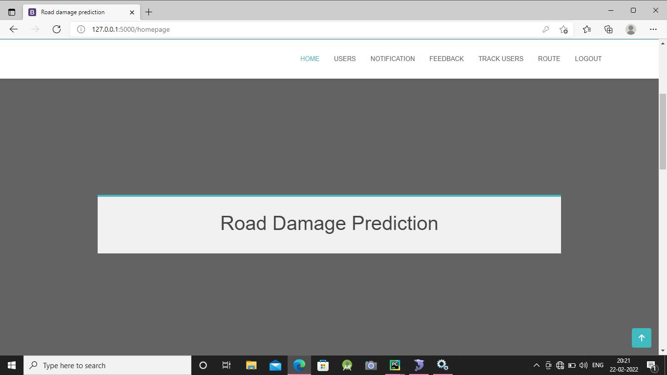
SCREENSHOTS

Slide 22
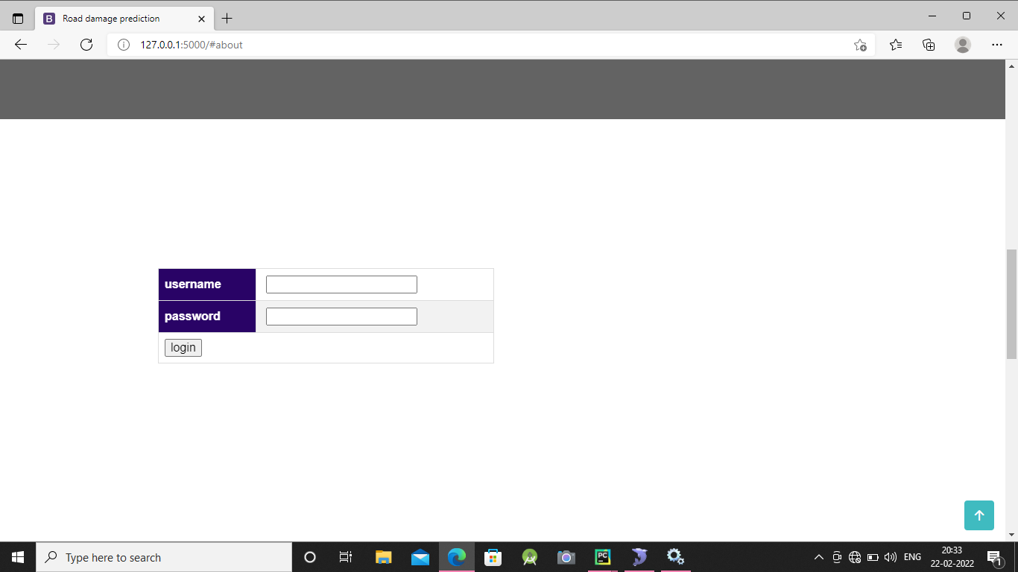
SCREENSHOTS

Slide 23
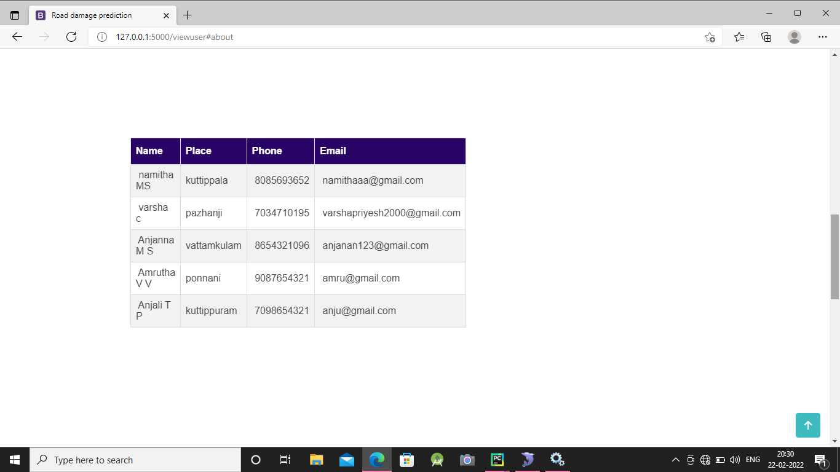
SCREENSHOTS

Slide 24
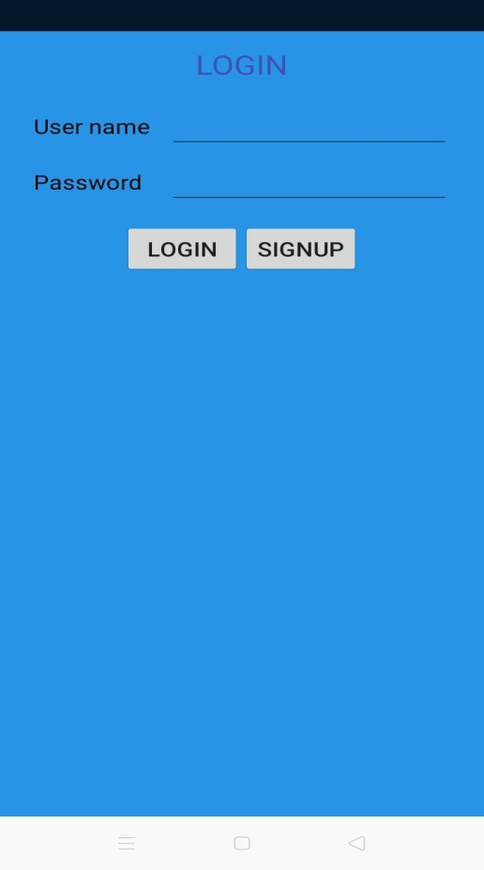
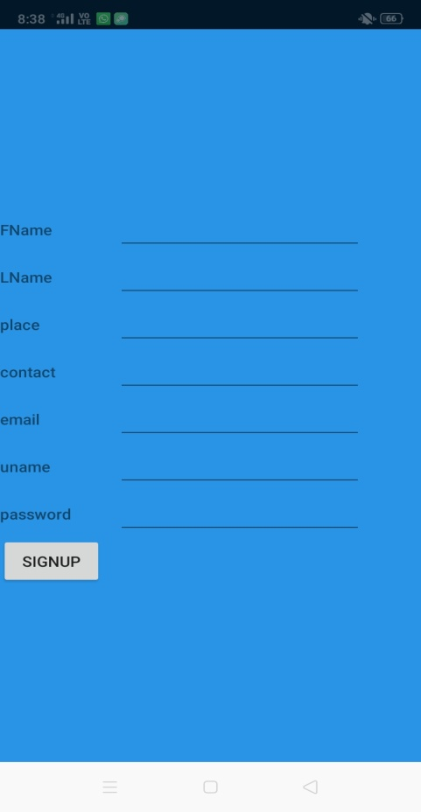
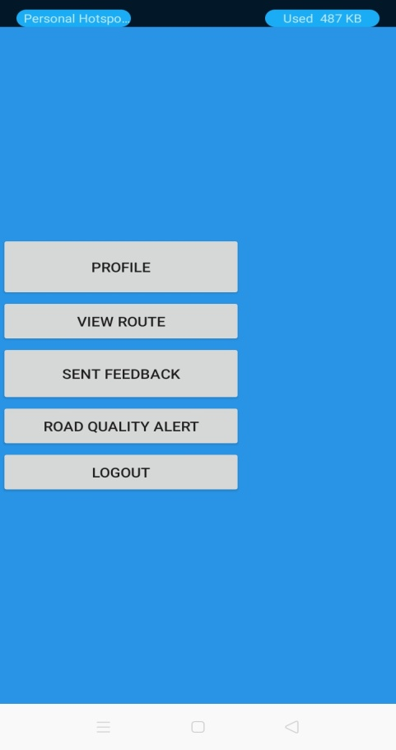
SCREENSHOTS

Slide 25


